Slide 1
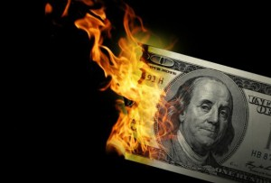
CS1951 L
Blockchains & Cryptocurrencies
Fall 2025
Lecture 17
Privacy and Anonymity
Maurice Herlihy
Brown University

Slide 2
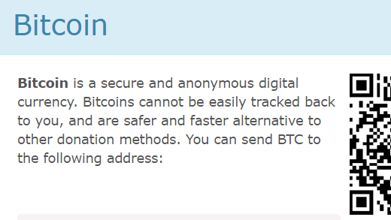
WikiLeaks Says …

Slide 3
Is Bitcoin Really Secure & Anonymous?

Slide 4

Ilya Lichtenstein
Heather Morgan
Writer for Forbes
Founder, Y-Combinator funded startup
Tik-Tok Rapper

Slide 5
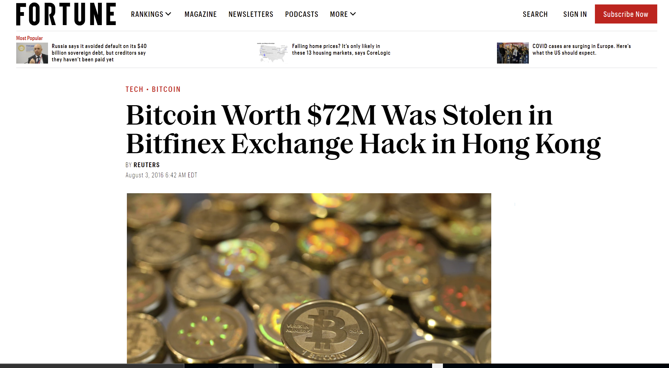
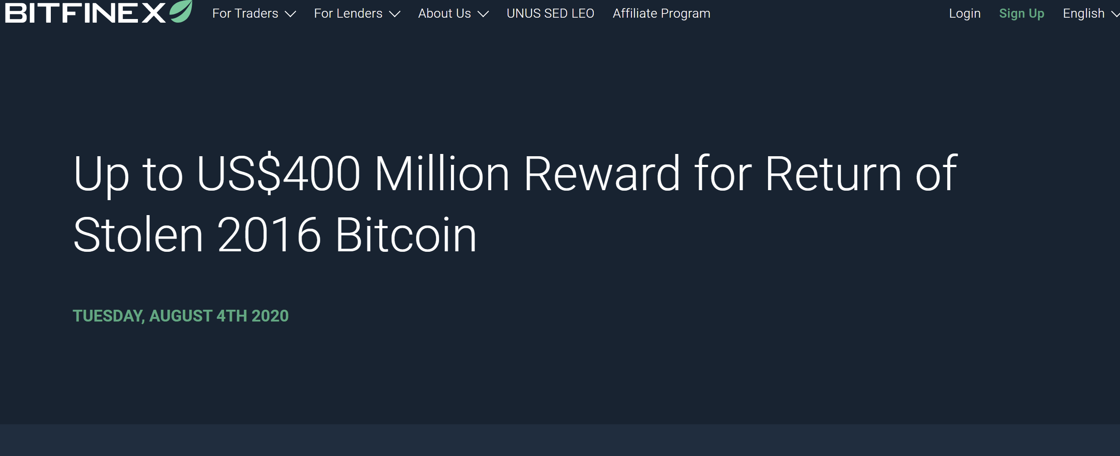
August 2016

Slide 6
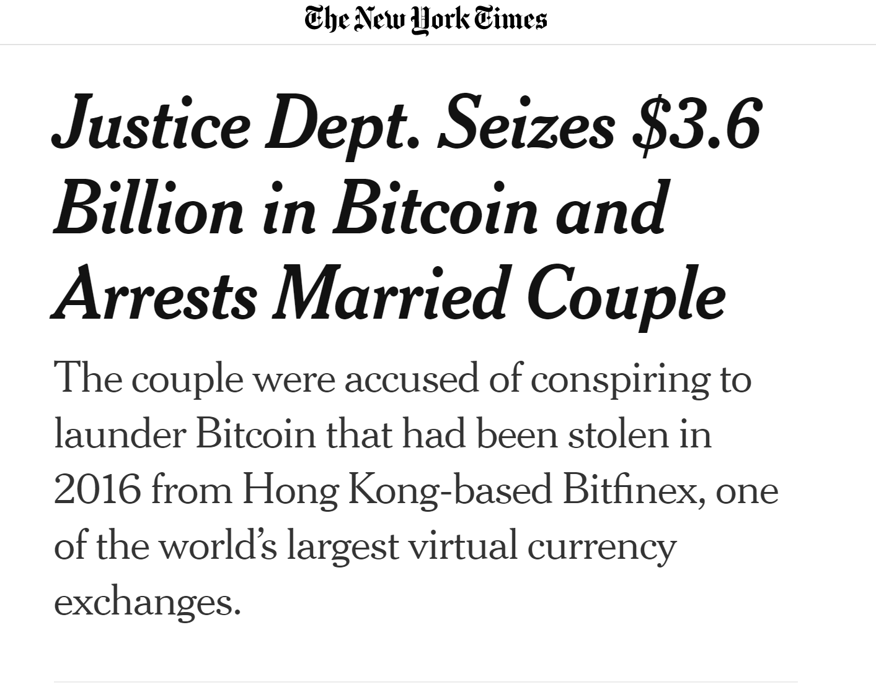
February 2022

Slide 7
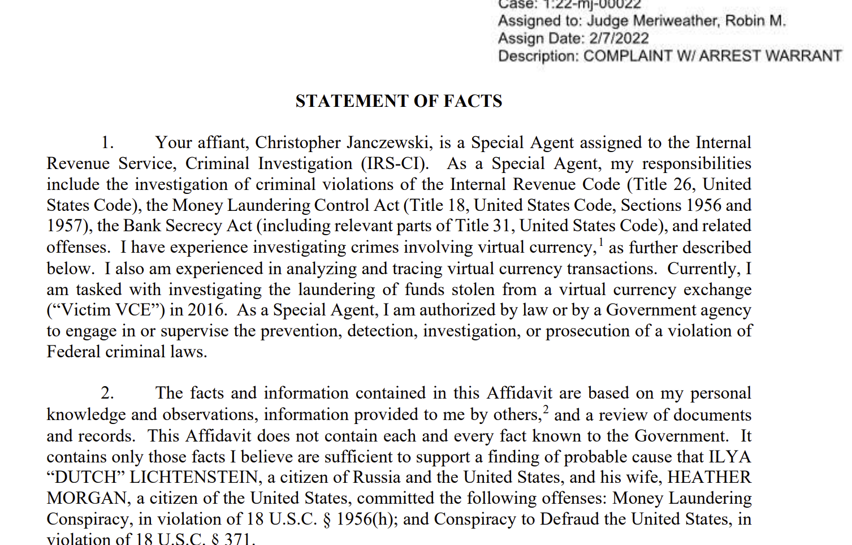
From FBI legal complaint …
In 2016, 119,754 BTC stolen, moved to address 1CGA4s ...
Then worth $71 M, now $4.5 B
In 2017, small portion of stolen BTC moved out that address…

Slide 8
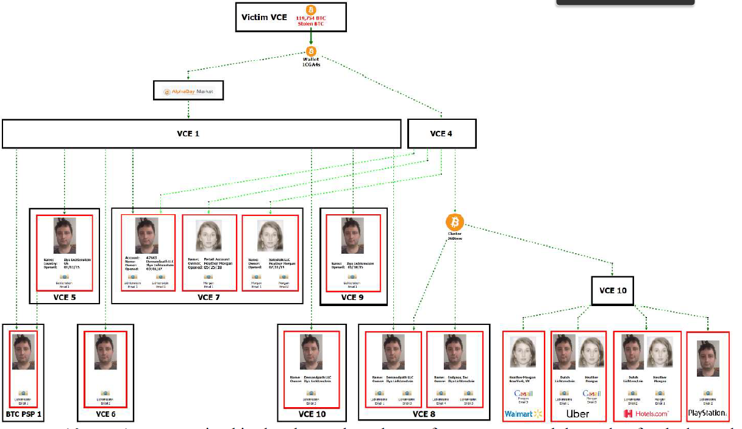
“using accounts set up with fictitious identities …”
“moving the stolen funds in a series of small amounts, totaling thousands of transactions …”

Slide 9
“utilizing computer programs to automate transactions, a laundering technique that allows for many transactions to take place in a short period of time…”
“layering the stolen funds by depositing them into accounts at a variety of VCEs and darknet markets and then withdrawing the funds”

Slide 10
“converting the BTC to other forms of virtual currency, including anonymity-enhanced virtual currency in a practice known as ‘chain hopping’…”
“using U.S.-based business accounts to legitimize activity” (Walmart, Uber, PlayStation gift cards)

Slide 11
Digital forensics
Trace transfers to the couple’s accounts
Device fingerprinting
Match with couple’s computers & phones
IP tracing
Track physical locations of devices
Undercover
Agents posed as crypto traders
Social Media monitoring

Slide 12

Privacy for Honest People?
Alice is paid in BTC
Should everyone know her salary?
Alice spends BTC
Should everyone know how much vodka she buys?

Slide 13
Why Privacy?
Pizza fast-food chain …
Quietly hires a falafel consultant…
Should competitors know?

Slide 14
Why Privacy?
But ransomware, drugs, terrorism, etc.?
Impossible to target only worthy uses of privacy!
Society is full of privacy compromises

Slide 15
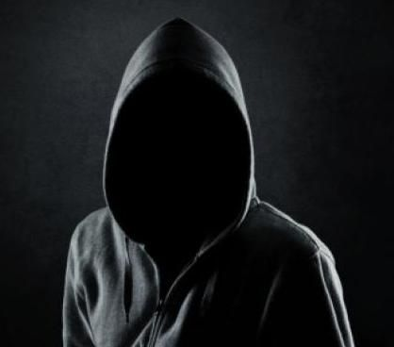
Anonymity
I just emptied your Bitcoin wallet, LOL
Interacting with no name at all

Slide 16
Pseudonymity
Hi, I’m
3leet-haxxor84!
Interacting under a name, just not yours

Slide 17
Bitcoin Addresses
Hash of public key
Not your name, …
But still a pseudonym ..
Even if you use lots of different addresses,
They can often be linked

Slide 18

Linkability
Every Bitcoin transaction is public
Visible to everyone
Repeated interactions can be linked to each other
And maybe directly to you

Slide 19

Pseudonymous is not Private
You order a latte at a coffee shop
And pay in Bitcoin
The barista has a link between you and that address
And from that address to prior addresses…

Slide 20
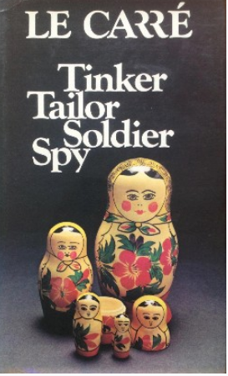
Side-Channel Attacks
In this cold war spy novel ..
MI-5 officer notices that encrypted transmissions from anonymous Soviet mole …
Paused while his colleague was on vacation!
Timing, amounts, patterns can link addresses

Slide 21
Unlinkability
It should be hard to link …
Different addresses of same party
Different transactions of same party
Payment sender to (ultimate) recipient

Slide 22
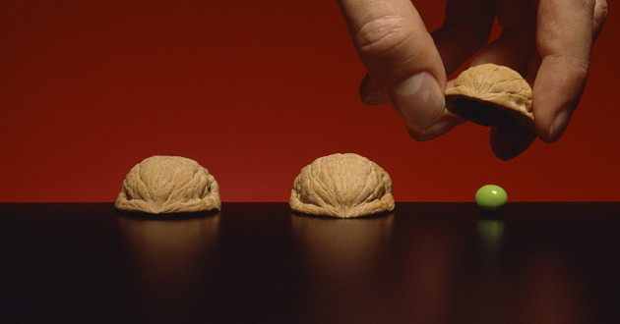
Anonymity Set
Set of transactions that …
The adversary cannot distinguish …
From yours.
Precise, but tricky …
Depends on adversary’s powers

Slide 23
Let’s De-Anonymize Bitcoin

Slide 24

I’m Alice
3
5
6

Slide 25

3
5
6
I want to buy that hat
8 BTC

Slide 26
3
txn
8
5
6
8 BTC

Slide 27
Adversary Sees
3
txn
8
5

Slide 28
Adversary Sees
3
txn
8
5
These two addresses probably controlled by same party!

Slide 29

Rewind
3
5
6
I like that hat better
8.5 BTC

Slide 30
Change Comes from Within
txn
3
8.5
5
6
0.5
8.5 BTC

Slide 31
Adversary Sees
txn
3
8.5
6
0.5

Slide 32
Adversary Sees
txn
3
8.5
6
0.5
One of those outputs is change for the inputs’ owner!

Slide 33
Adversary Sees
Some early wallets would always put the change in the same position, LOL
txn
3
8.5
6
0.5

Slide 34
Working Backwards
Many such addresses can be linked to a single party!

Slide 35
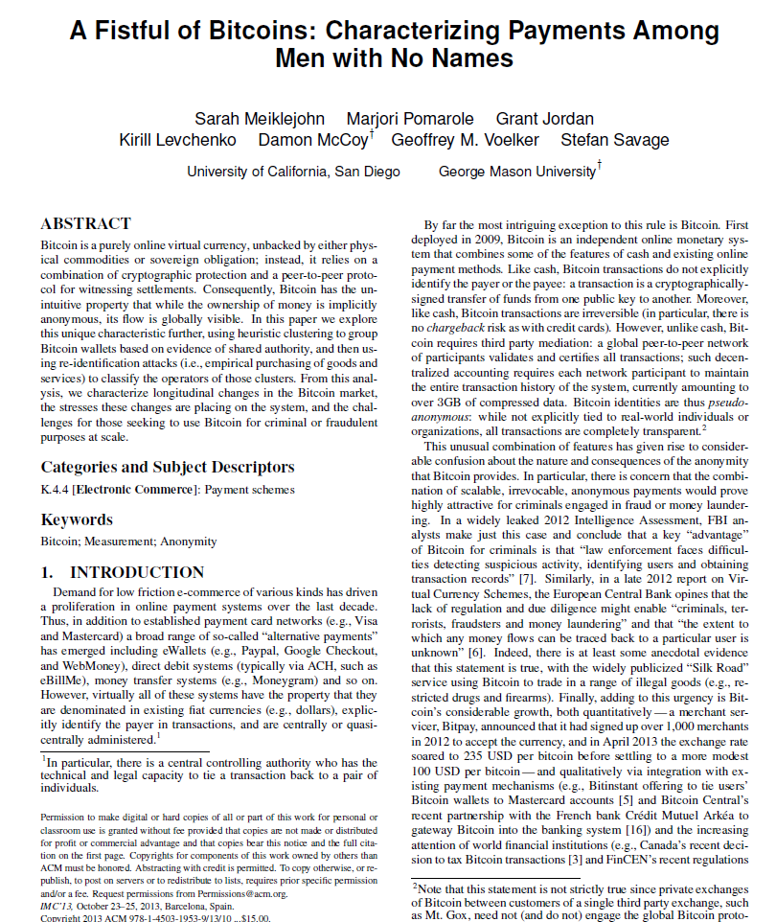
Uses heuristics to link bitcoin transactions
Industrial scale
“idioms of use”
E.g. change sent to newly minted address…
Merchant address seen before

Slide 36

Re-Identification Attack
How to connect addresses with institutions?
Buy stuff
Join mining pool
Engage wallet services
Join gambling sites

Slide 37
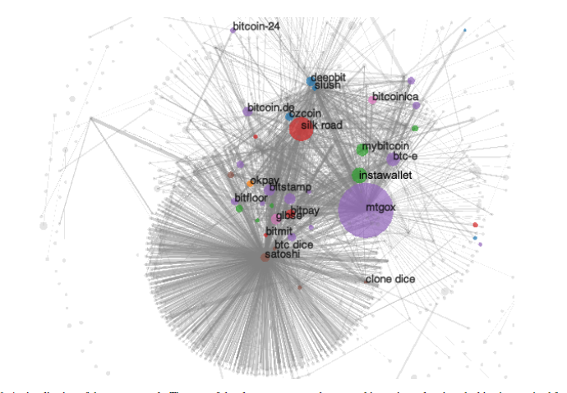
From Meiklejohn et al.
Clusters, color-coded by industry
Notes:
Figure 6: A visualization of the user network. The area of the cluster represents the external incoming value; i.e., the bitcoins received from
other clusters but not itself, and for an edge to appear between two nodes there must have been at least 200 transactions between them. The
nodes are colored by category: blue nodes are mining pools; orange are fixed-rate exchanges; green are wallets; red are vendors; purple are
(bank) exchanges; brown are gambling; pink are investment schemes; and grey are uncategorized.

Slide 38
Linking to Real-World People
Direct transactions
“Dusting Attack”
AML/KYC compliance
Carelessness:
e.g.., request donations to static address

Slide 39
Dusting Attack
Airdrop!
Yay!
Yay!
Yay!

Slide 40
Dusting Attack
10⁻⁸
10⁻⁸
10⁻⁸
Oh…
Oh…
Oh…
Give everyone a tiny sum
(each to a unique address)

Slide 41
Dusting Attack
It’s so annoying to have
all these UTXOs …
1000
10⁻⁸

Slide 42
Dusting Attack
I have you now, my pretty!
I just linked your 1000+ address with you!
I’m going to clean up & consolidate!
1000
txn
1000+
10⁻⁸

Slide 43

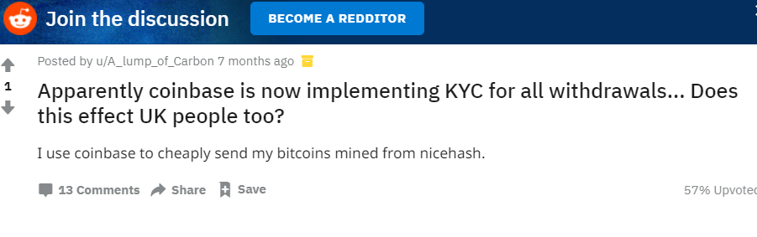
AML/KYC
Anti-Money Laundering
Know Your Customer
Financial institutions are required to find out who you are
Trade BTC all you like, but when you cash in, your identity becomes known

Slide 44
Network-Level Attacks
Txns flow through P2P network
Nodes can collude to identify parties
First node to announce transaction is probable source
Identify origin IP address
Partial solution: Tor network hides IP address, not ideal

Slide 45
Let’s Re-Anonymize Bitcoin

Slide 46
Peel Chain
Large amount of bitcoin
coins
Sent through long sequence of addresses
Small amount peeled off each time
exchange
exchange
Does not work
exchange
exchange
Detected & Analyzed by Meiklejohn et al.
Failed for Lichtenstein-Morgan

Slide 47
Use intermediary to obfuscate ownership

Slide 48
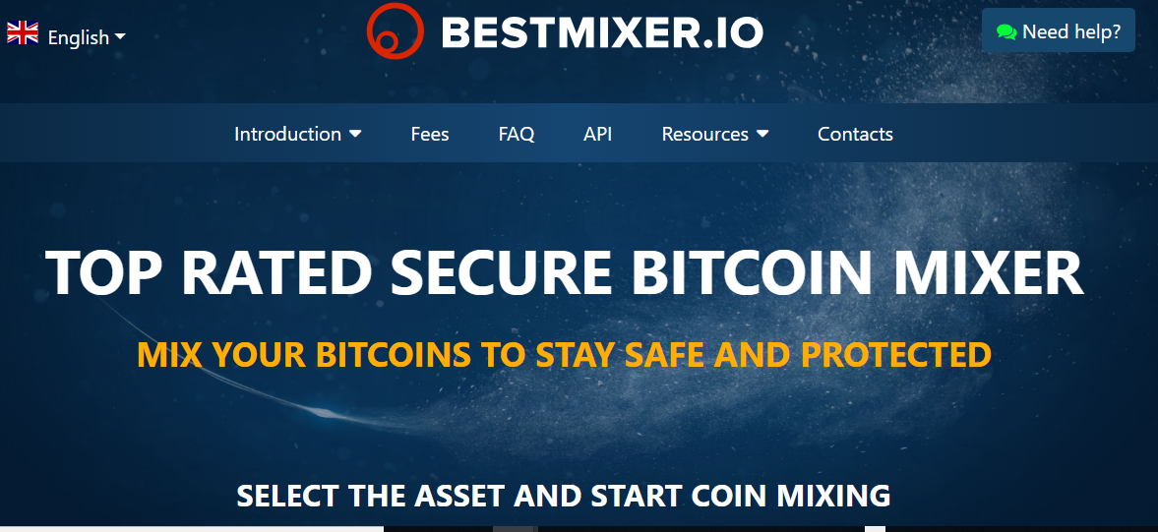
Mixing Services
On-line services
Send them your bitcoins
Give the mixer a destination address
Hope that mixer sends your coins to that address
Simultaneously with others in anonymity set

Slide 49
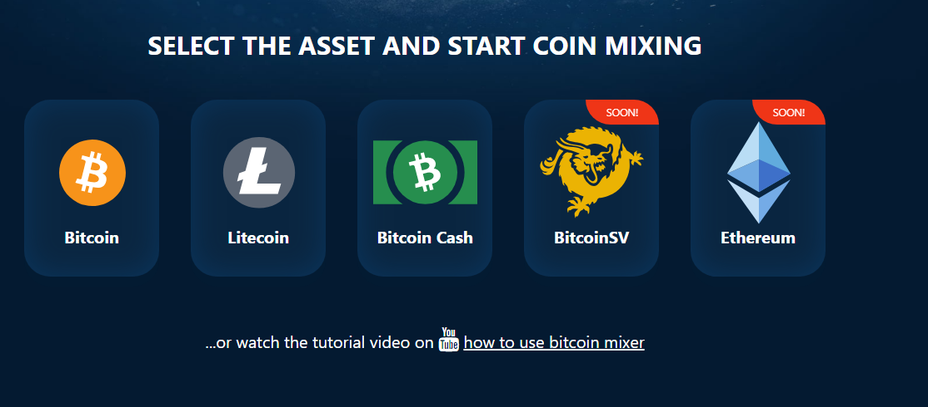
You Trust That …
They don’t keep records
They don’t keep your coins
They don’t give you “tainted” coins
Anonymity set not too small

Slide 50
Best Practices
Use a sequence of mixers
You are OK if at least one discards records

Slide 51
Best Practices
Use standard “chunk” amount

Slide 52
Best Practices
Seriously, dude?
Use standard “chunk” amount

Slide 53
Beware of Fees
3
2.993
3
2.991
3
2.989

Slide 54
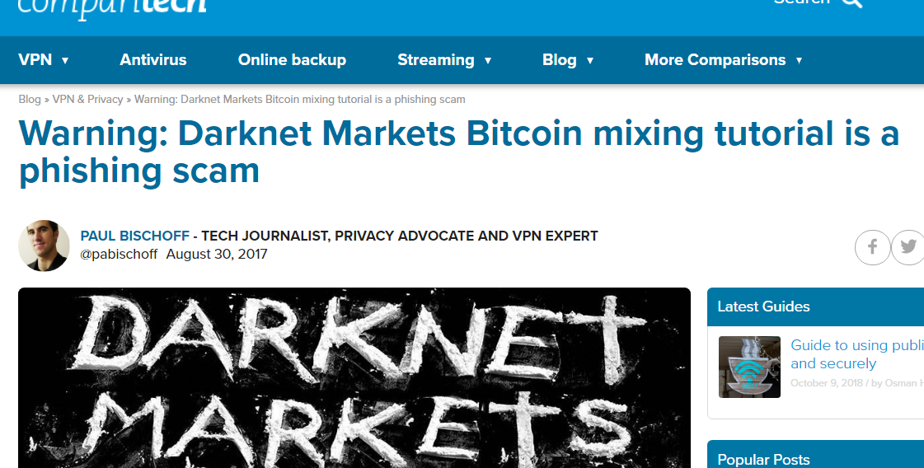
Mixing Services Today

Slide 55
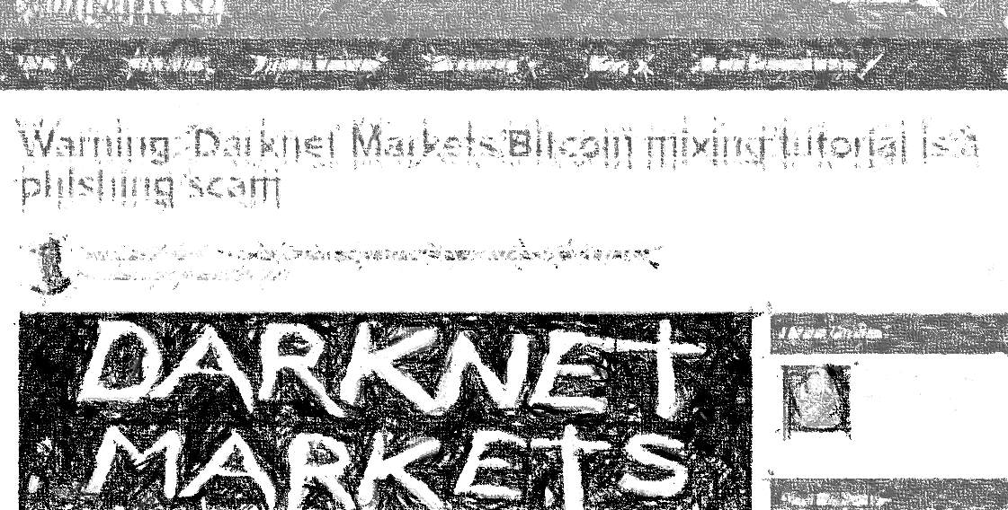
Mixing Services Today
Low
usage
Dodgy
reputation
Small anonymity sets

Slide 56
Decentralized Mixers

Slide 57
Decentralized Mixers
Peer-to-Peer
No Theft
Better anonymity maybe
More aligned with BTC philosophy?

Slide 58
CoinJoin
Single transaction

Slide 59
CoinJoin Protocol
Find Peers who want to mix
Exchange input, output addresses
Construct transaction
Send it around, collect signatures, validate
Broadcast the transaction

Slide 60
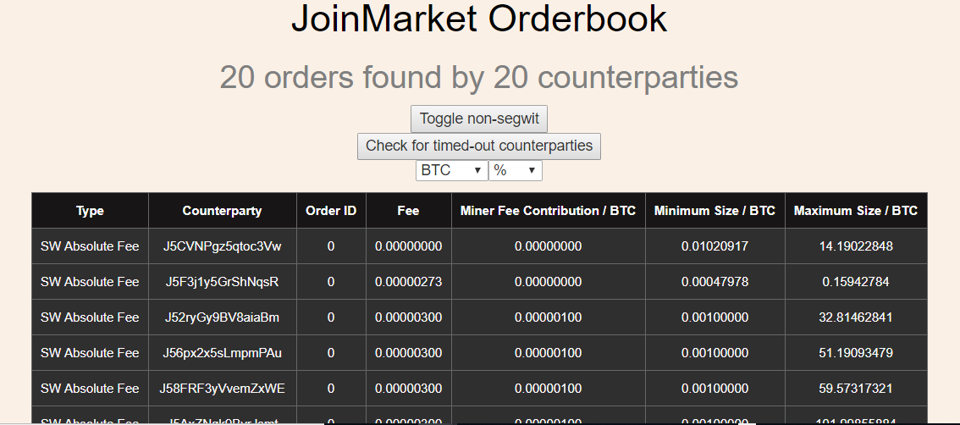
Find Peers who Want to Mix
Services that match up interested parties
Unlike mixer services, cannot steal your funds
Cannot compromise identity
Sometimes charge fees

Slide 61
Exchange Input, Output Addresses
Tricky …
No one should know input-to-output mapping
Maybe use Tor
Or special-purpose anon routing

Slide 62
Denial of Service
Peer might not sign transaction
Peer might spend coin before transaction broadcast
Fix: fees, bonds, blame protocols?

Slide 63
Best Practices Still Apply to CoinJoin!
Mix multiple times
Use fixed-size chunk amounts
Beware of fees reducing that chunk

Slide 64

Paranoia Strikes Deep
secretly
CoinJoin
transaction
you
you
secretly

Slide 65
Merge Avoidance
3
5
6
I want to buy that hat
8 BTC

Slide 66
Merge Avoidance
txn
3
3
txn
5
5
6
I need to be careful about combining outputs
8 BTC

Slide 67
What about Ethereum?

Slide 68







Lists of sanctioned people, organizations
No U.S. person can do business …
(“U.S person” is anyone on U.S. soil or U.S. citizen anywhere)
Extended to Ethereum, Bitcoin addresses!

Slide 69

Tornado.cash
Launched 2019
Decentralized, community-governed
Open-source
Non-custodial
Make Ethereum txns untraceable & unlinkable

Slide 70
Tornado.cash Deposit
I have a secret deposit note d
1 ETH
H(d)
I remember H(d) and 1 ETH

Slide 71
Mixology
Wait a while for my deposit to mix with others’ …

Slide 72
Tornado.cash Withdrawal
ZK-proof(S,L)
H(S)
Split d into secret S & lock L
From this, I prove
Caller deposited ether
That ether is still there

Slide 73
Tornado.cash Withdrawal
1 ETH
I remember L to prevent multiple withdrawals

Slide 74

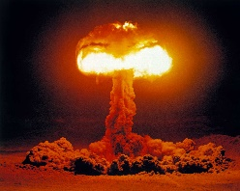
The Problem
In 2022, NoKo earned 10X more from hacking than trade
Stolen ETH
$900M
UN report: crypto thefts fund

Slide 75
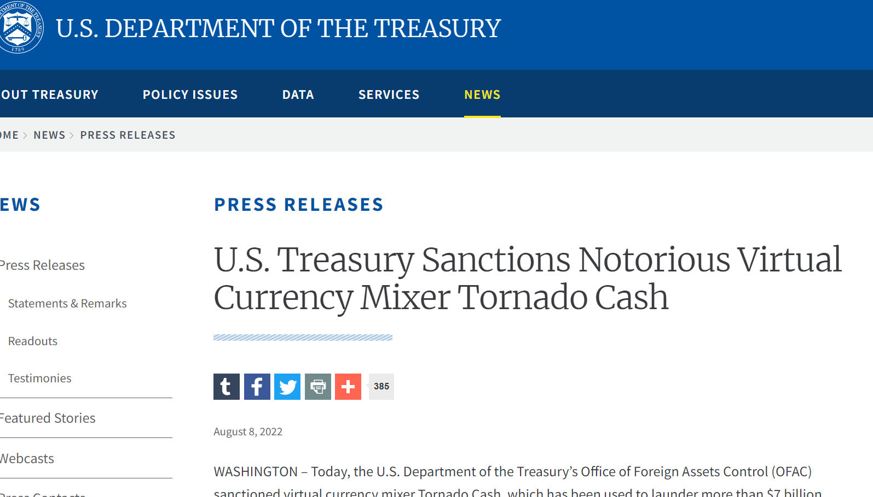
August 2022
Tornado Cash Sanctioned by OFAC
45 Wallet addresses
But also software itself!
TC’s “property & interests” blocked!?
What does this mean?

Slide 76
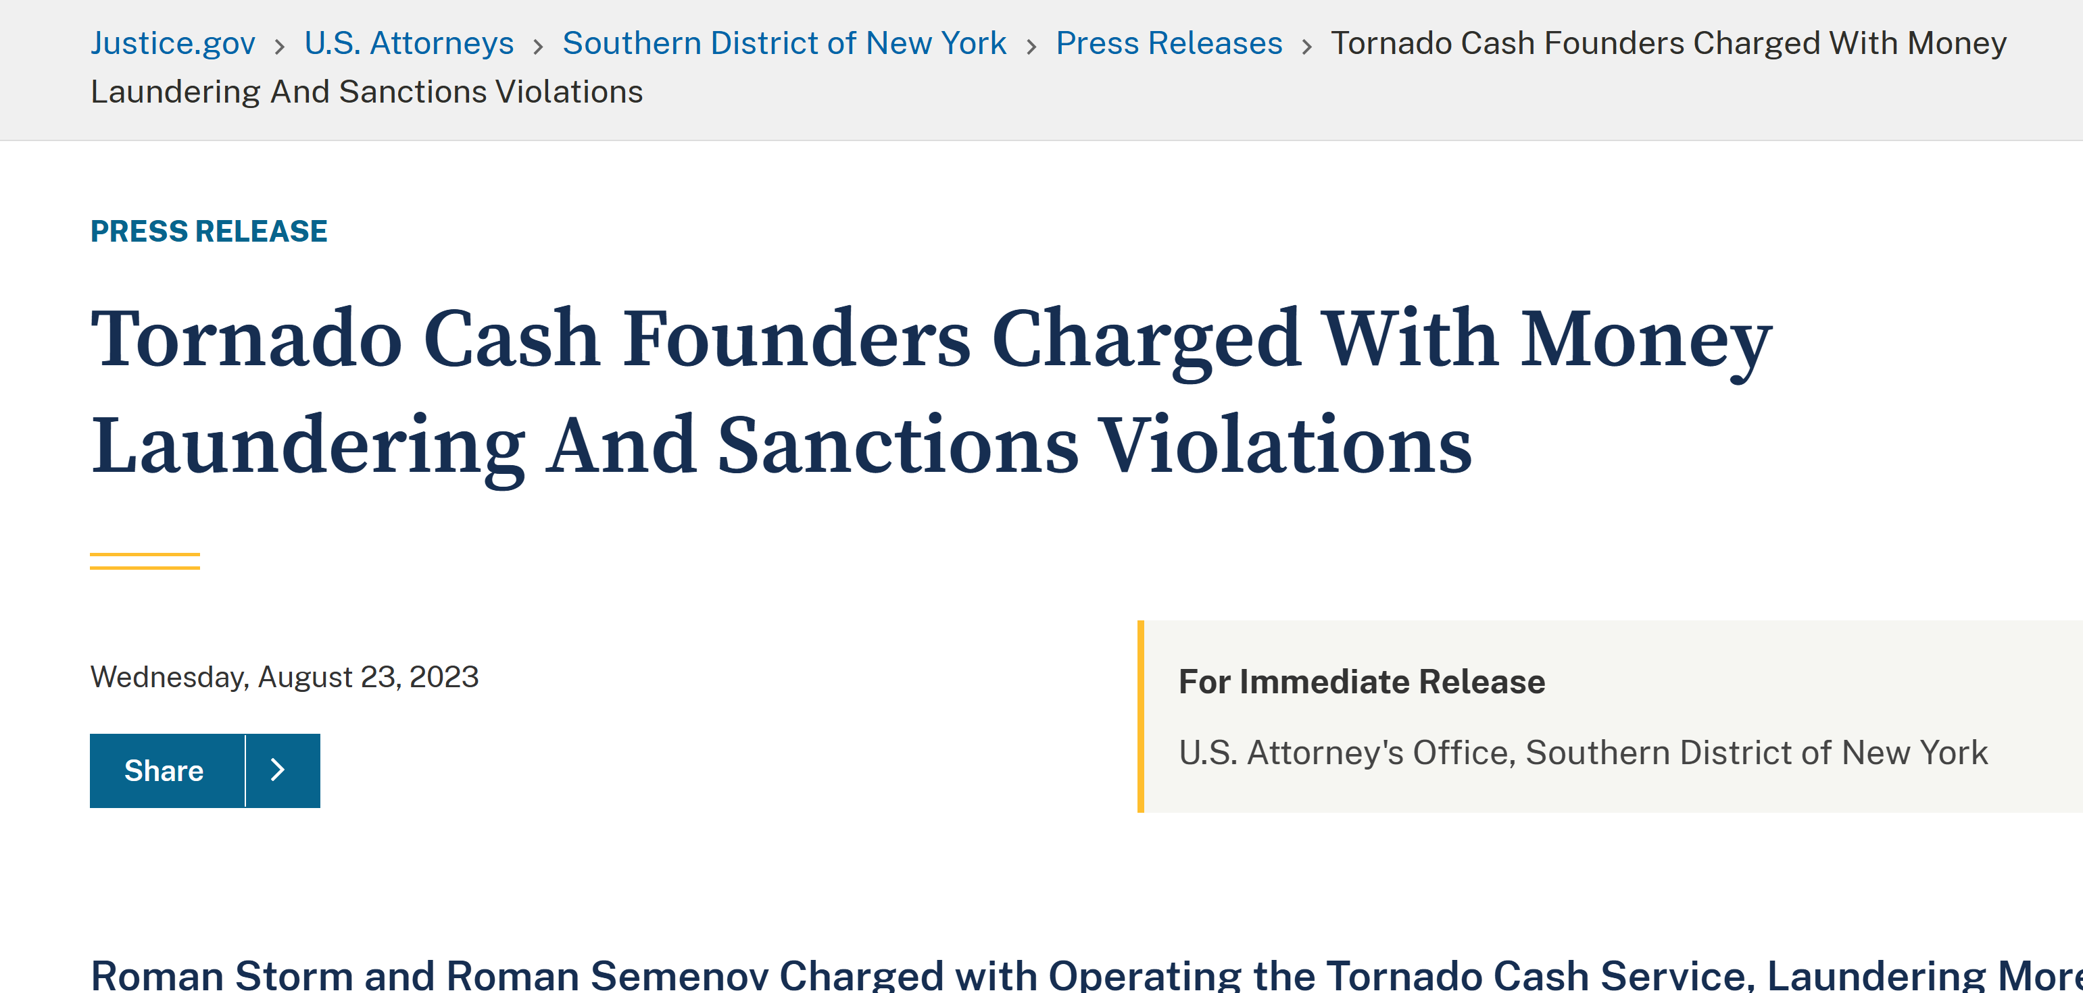

Slide 77
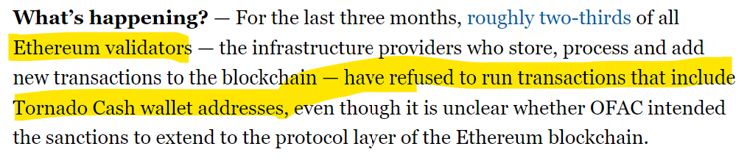
Censorship-Resistance?
Can validators be sanctioned?
Are validators neutral (like internet nodes)?
Is Ethereum censorship-resistance a lie?

Slide 78
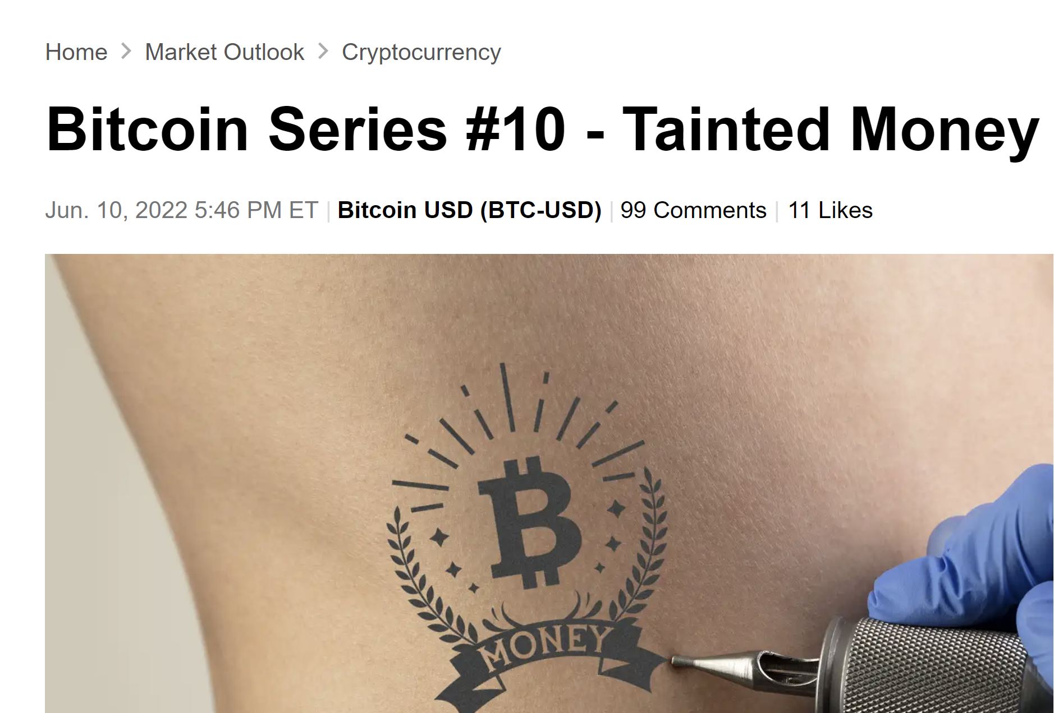
Coins from sanctioned address are tainted
Cannot legally be accepted by U.S. exchanges
If Alice accepts tainted ether …
Is all her ether now tainted?
What if she shares mixer with tainted ether?
How far does taint extend?

Slide 79

Degrees of Taintedness
tainted
Indirectly
tainted
Tainted
by association

Slide 80
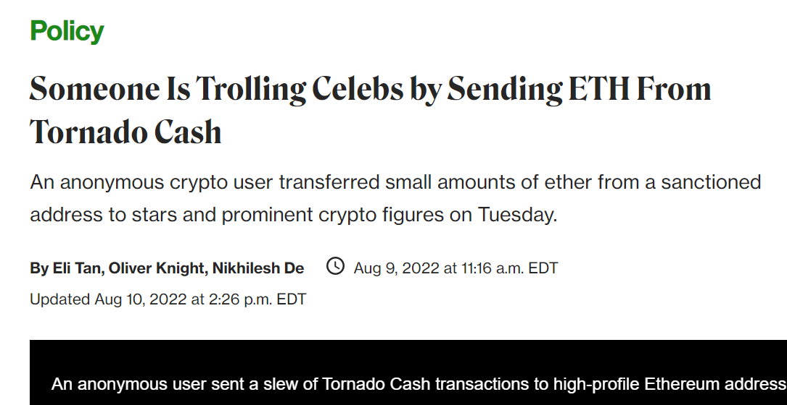
August 2022
Someone sent small amount of tainted ether to lots of celebrities
Actors, musicians, tech CEOs …
Illegal to accept, but …
Impossible to block!
Law assumes “gatekeeper” banks, etc.

Slide 81
Chilling Effect
Any open-source project can be taken up by bad actors
Any developer working on a privacy-related project is in danger of having work sanctioned
But code is “speech” by legal precedent
Protected against government restriction by the 1st Amendment of U.S. Constitution
This story is not over

Slide 82

Detecting Suspicious Transactions
Use of P2P exchanges, mixing services
From countries with weak national measures
Irregular, unusual or uncommon txn patterns
Amount & frequency has no logical business explanation
Sender or recipient profiles
Source of funds or wealth
Notes:
Image from Adobe stock images. https://stock.adobe.com/search?k=suspicious+person

Slide 83

Myth-Busting
Ethereum, Bitcoin not so censorship-resistant
Ethereum, Bitcoin not so fungible
Real life is complicated …
Always question crypto dogma
Notes:
Background image from clipartmax https://www.clipartmax.com/download/m2i8H7d3A0K9m2H7_wrecking-ball-icon-wrecking-ball-clip-art/

Slide 84
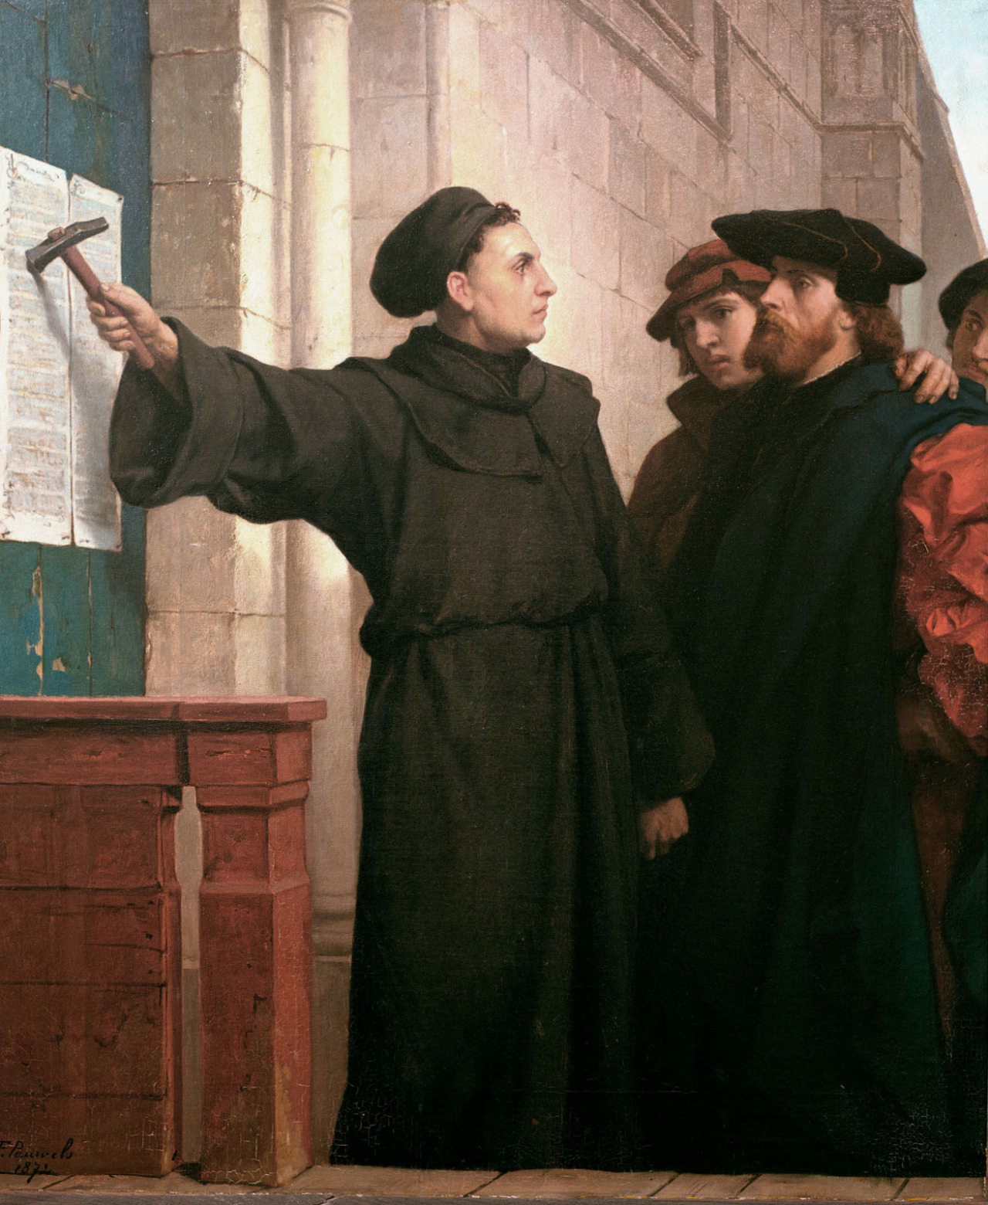
Ideas we covered in this lecture
Anonymity vs Pseudonymity
Linkability: heuristics, side-channels, etc..
Dusting Attack
AML / KYC
Mixers, central, P2P, best practices
Sanctions & consequences

Slide 85
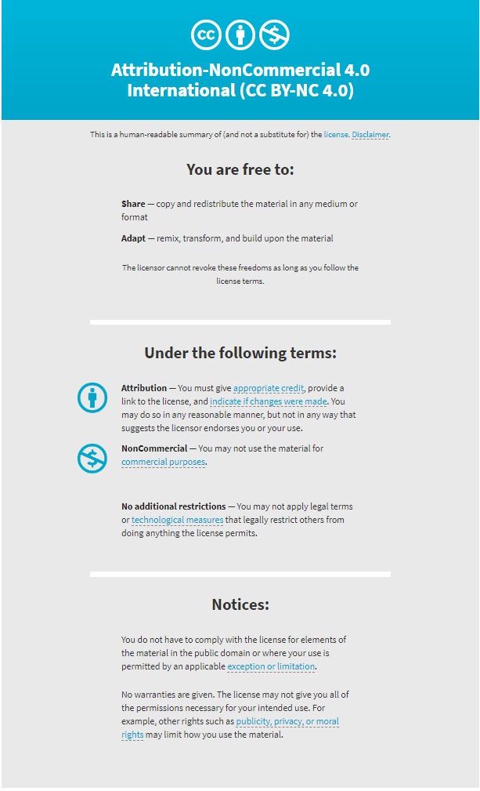
ss

